Slide 1

Project Work Photo upload system 40-50% work
Prachurja Kanti Barman Praggo
UG02-49-18-002
State University of Bangladesh
40-50% work

Slide 2


Introduction
Webpage
Login System
Registration System
Logout System
Photo upload

Slide 3

Options
Upload photos
Delete photos
People can see Photos (who are registered)

Slide 4

Language
PHP
HTML
CSS
MySQL

Slide 5

Environment
Editor
visual studio code, Sublime Text Editor
Server
Apache
MySQL-Server
XAMPP

Slide 6


Login Page
Outlook
Design
Slider

Slide 7


Signup Page
Outlook
Design
Slider

Slide 8

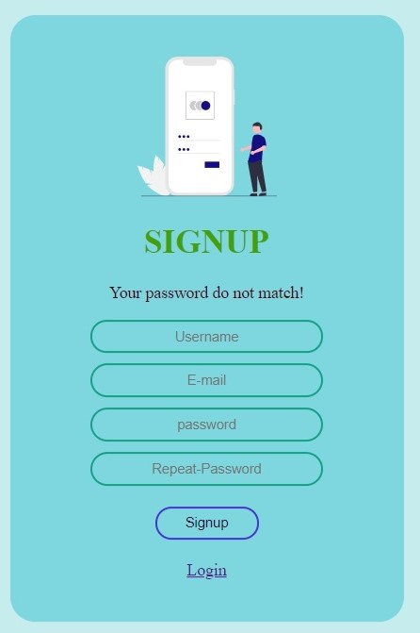
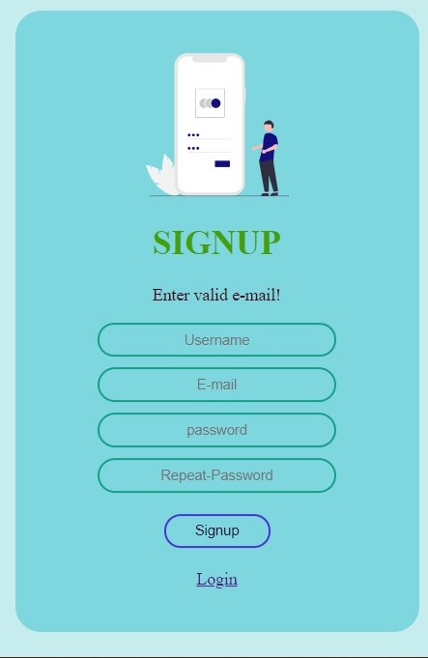
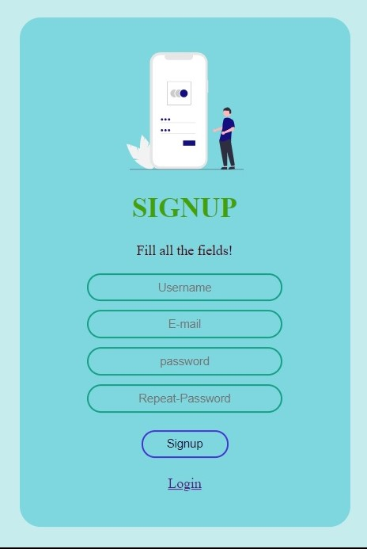
Signup Page
Error handling
With php
Hash
Password

Slide 9

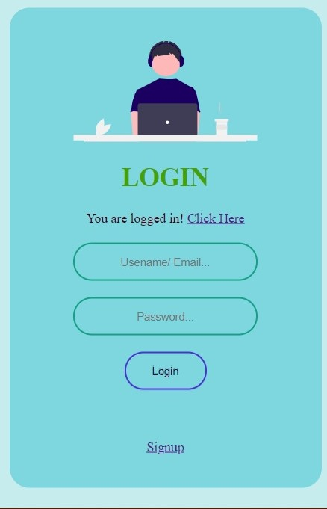
Login Page
Successfully Login
Go to Homepage

Slide 10


Home Page
Welcome
Show name
logout

Slide 11

Logout
Back in Login Page
Future
Photo Uploading
Photo view

Slide 12


